Slide 1
Transitioning to Preschool
2021

Slide 2
Challenges to Transitioning to Preschool
What can you do at home to help prepare your child for this big and important developmental transition?

Slide 3
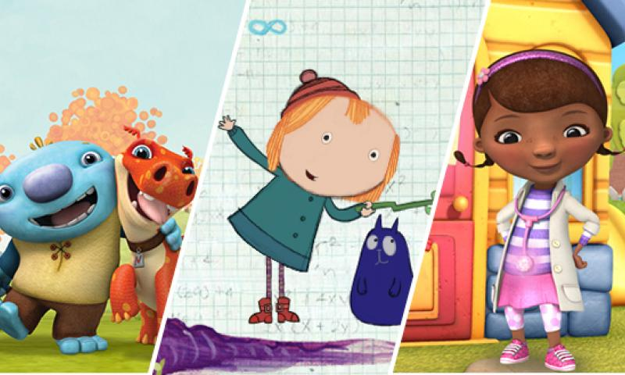
Read and Watch
Read books about going to preschool and about some of the feelings they may have.
Watch children’s episodes about going to preschool and discuss them afterwards with your child.

Slide 4
Talk and Listen
Talk to your child about the upcoming transition to school. Answer their questions and try to calm any fears or insecurities they may have.
Talk about some of the rules and expectations in class and why they are important.
Print a simple calendar and mark off or put stickers on the days to count down to the first day of school.
Walk by school and talk about going to school
Practice morning routine

Slide 5
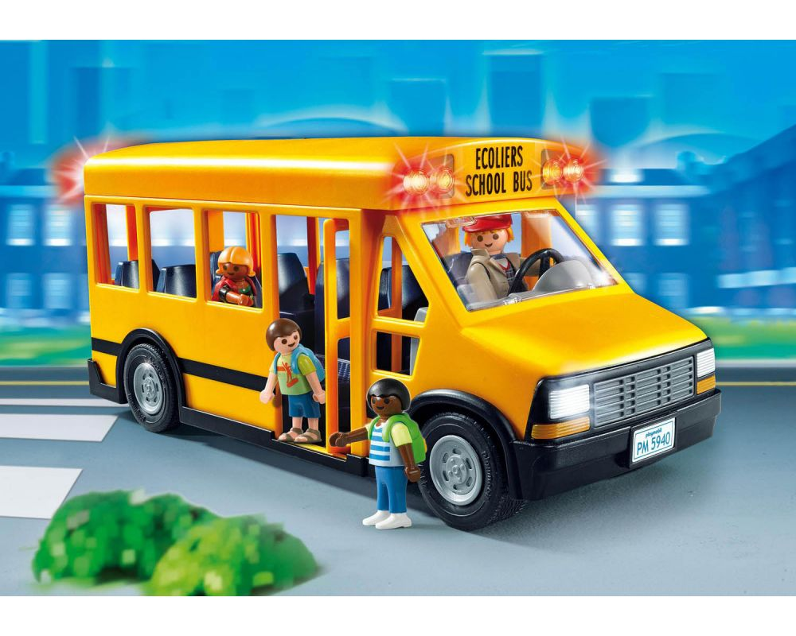
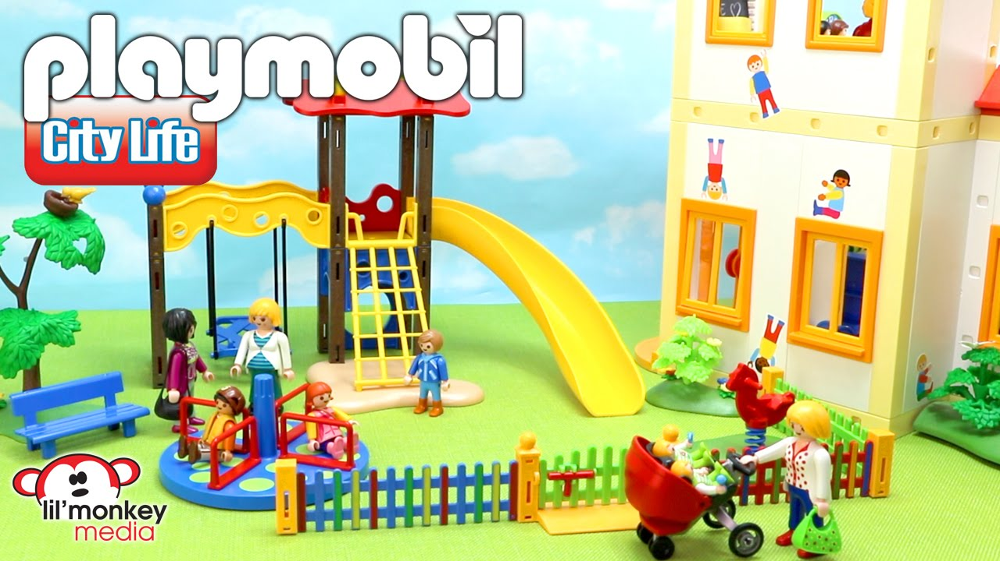
Play and Practice
Play with them using toys that represent school.
Use stuffed animals as the students and you can be the teacher and then switch and have your child be the teacher.
Play with school houses, buses, school playgrounds and act out different scenarios.
Practice using the classroom rules in play. Role play some concerns or fears and help them find solutions through play.
Teach and practice social skills and sharing through pretend play.
Practice school schedule and routine

Slide 6
Routines: Sleep and Nutrition
“When you give your body the best possible fuel, you have more energy, you’re stronger, you think more quickly.”
-michelle obama
Preschool aged children need 10 -13 hours of sleep per night
Some children may still need a nap during the day of about an hour
Set bedtime routines that work for your family
Set meal and snack times
Offer a variety of foods including grains, meat, vegetables, and fruits

Slide 7
Reward and Reinforce
Research on How to Change Behavior
The book “The Kazdin Method for Parenting the Defiant Child with No Pills, No Therapy, No Contest of Wills” was developed and written by Dr. Alan Kazdin, Ph.D.
It is based on extensive research on what really works to change behavior in children.
Research has proven that punishment does not change behavior in the long-term.
Positive reinforcement of the desired behavior creates more of that behavior and makes long-lasting changes.
Positive reinforcement does not only mean material rewards. In fact, some of the best reinforcement happens with labeled verbal praise, affection, and acknowledgment.

Slide 8
Challenges to Transitioning to Preschool
Staying at home can be comfortable for your child. And as we know, home does not have the same type of structure that classrooms have.
Change in the routine and schedule can feel unsettling to your preschooler.
Adjusting to the structure and expectations of the classroom may be very challenging for your child.
Being away from you and home can feel overwhelming and scary for them.
Sharing with other children can also pose challenges.
It is normal for some children to struggle with this transition and to have strong emotions or behaviors while they are adjusting.

Slide 9
Behavioral or Emotional Concerns
How do you know if there is a more serious concern regarding your
child’s behavior or emotions?
The teacher talks to you about their concerns regarding your child’s behavior in the school.
Your child is frequently aggressive with other children, with the teacher, or with you.
You are frequently called to pick your child up due to behavioral challenges.
You are informed that your child can no longer attend that school due to dangerous behaviors.
You have a hard time doing errands or tasks because your child has such severe tantrums you can’t take them out.
Their behavior causes you to fear for their safety, such as running away from you, jumping from high places, or hurting themselves or others.

Slide 10
Thank you!

